Slide 1

Software Engineering
Lecture - 2

Slide 2
Content
Week-01
The nature of software
Software application domains
Intro. to software engineering
Software process framework
Week - 2 | Process models Waterfall Incremental Iterative V- model Spiral Prototyping

Slide 3

In Software
One thing is constant that is Change

Slide 4
Software Process

Slide 5
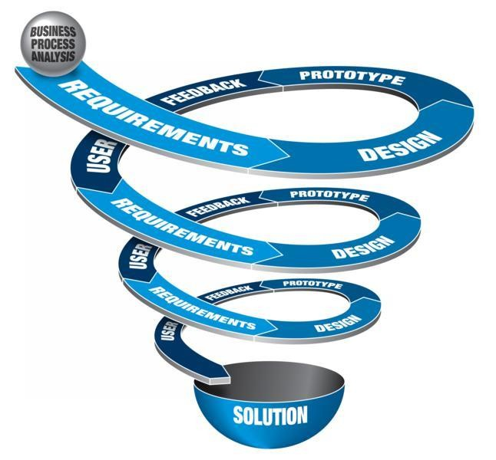
What is Software Process?
“A software process is a set of related activities that leads to the production of a software product.”

Slide 6
The software process
Many different software processes but all involve:
Specification – defining what the system should do;
Design and implementation – defining the organization of the system and implementing the system;
Validation – checking that it does what the customer wants;
Evolution – changing the system in response to changing
customer needs.
Design and Implementation
Validation
Evolution
Specification

Slide 7
Software Process Models

Slide 8
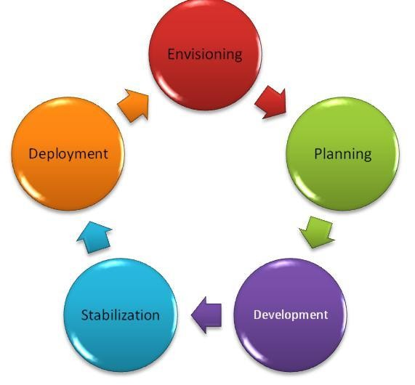
Software Process Models
A software process model is a simplified representation of a software process.
Each process model represents a process from a particular perspective.
Provides only partial information about that process

Slide 9
Process Model
Defines a distinct set of activities, actions, tasks, milestones, and work products that are required to engineer high-quality software
The activities may be linear, incremental, or evolutionary
9

Slide 10

Waterfall Model

Slide 11

The Waterfall Model
The first published model of the software development process (Royce, 1970)
Because of the cascade from one phase to another, this model is known as the ‘Waterfall Model’
Plan and schedule all of the process
activities before starting work on them

Slide 12
Waterfall Model (Diagram)
Communication
Project initiation
Requirements gathering
Planning
Estimating
Scheduling
Tracking
Modeling
Analysis
Design
Construction
Code
Test
Deployment
Delivery
Support
Feedback
12

Slide 13
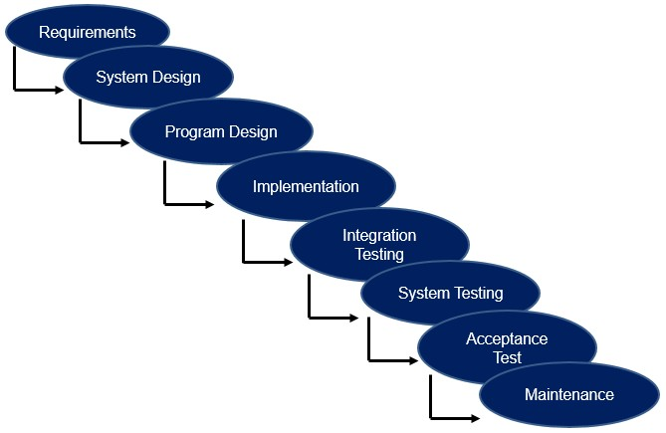
The Waterfall Model - Pros
Simple, manageable and easy to understand
Fits to common project management practices (milestones, deliverables etc.)
Focus on requirements and design at beginning, save money and time at the end
Can be suitable for short projects (some weeks)
Can be suitable for "stable" projects, where requirements do not change
Focus on documents, saves knowledge which can be reused by other people.
Widely used, e.g. US Department of Defense
Can be suitable for fixed-price contracts

Slide 14
Problem?

Slide 15
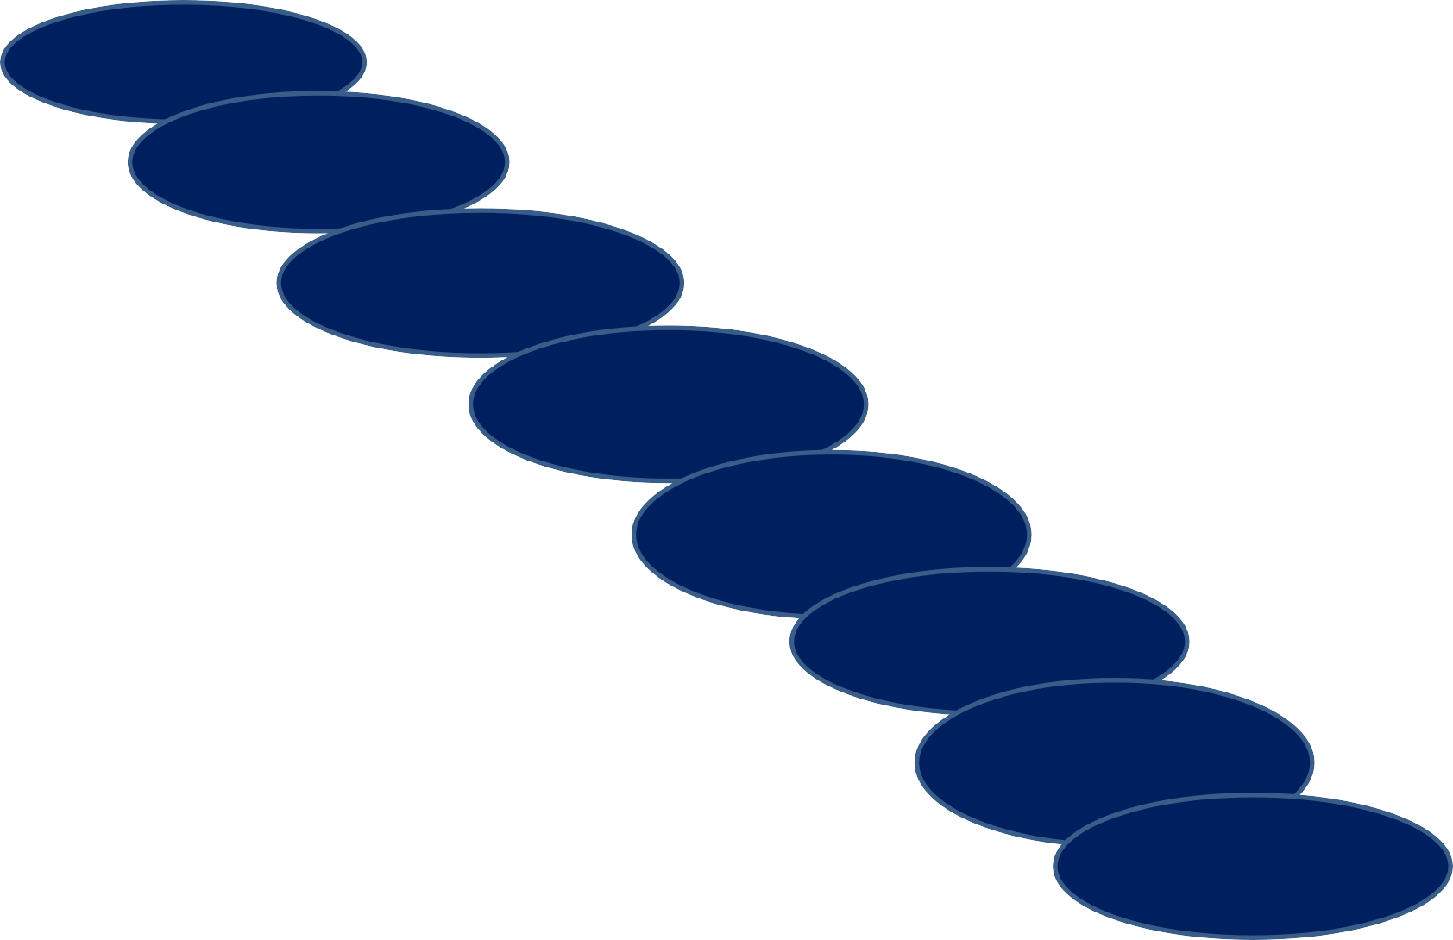
The Waterfall Model
Requirements
Finish each phase
before continue to next
System Design
Why is the waterfall model so criticized?
Which are the problems? Can it be useful sometimes?
Program Design
Implementation
Integration Testing
System Testing
Milestone and deliverable at
each step. (Artifacts such as Design
Acceptance
Test
Maintenance
document, Requirement
Specification. etc.)

Slide 16
Waterfall model problems
Inflexible partitioning of the project into distinct stages makes it difficult to respond to changing customer requirements.
Therefore, this model is only appropriate when the requirements are well-understood and changes will be fairly limited during the design process.
Few business systems have stable requirements.
The waterfall model is mostly used for large system engineering projects where a system is developed at several sites.
In those circumstances, the plan-driven nature of the waterfall model helps coordinate the work.

Slide 17
The Waterfall Model - Cons
Software requirements change, hard to sign-off on a SRS.
Early commitment. Changes at the end, large impact.
Feedback is needed to understand a phase. E.g. implementation is needed to understand some design.
Difficult to estimate time and cost for the phases.
Handling risks are not part of the model. Pushes the risks forward.
Software "is not" developed in such a way. It evolves when problems are more understood.
Doesn't support iteration, so changes can cause confusion
Difficult for customers to state all requirements explicitly and up front
Requires customer patience because a working version of the program doesn't occur until the final phase
Problems can be somewhat alleviated in the model through the addition of feedback loops

Slide 18
Can We Improve the Model?
Iteration back to previous phase
Danger! e.g. a performance problem can result in a major requirements change. Very expensive rollback...

Slide 19
Waterfall Model with Feedback (Diagram)
Communication
Project initiation
Requirements gathering
Planning
Estimating
Scheduling
Tracking
Modeling
Analysis
Design
Construction
Code
Test
Deployment
Delivery
Support
Feedback
19

Slide 20
V - Model

Slide 21
V Model
The V-model is a variation of the waterfall model that demonstrates how the testing activities are related to analysis and design
Developed by the German Ministry of Defense
Unit and system testing verify the program design, ensuring that parts and whole work correctly
Acceptance testing, conducted by the customer rather than developers, validates the requirements, trying each system function meets a particular requirement in the specification

Slide 22
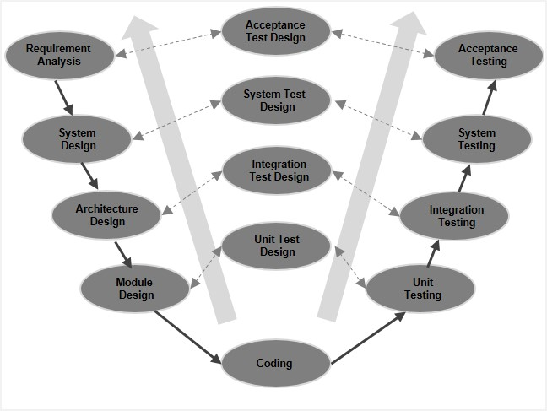
V- Model

Slide 23
V Model (Pros)
It defines tangible phases of the process, and proposes a logical sequence in which these phases should be approached
It also defines logical relationships between the phases
It demands that testing documentation is written as soon as possible
It gives equal weight to development and testing
It provides a simple and easy to follow map of the software development process

Slide 24
V Model (Cons)
It is too simple to accurately reflect the software development process
It is inflexible; it has no ability to respond to change
It produces inefficient testing methodologies

Slide 25
Phased Development (Incremental & Iterative Model)

Slide 26
Phased Development
Design a system so it can be delivered in pieces, letting users have some functionality while the rest is under development
There are usually two or more systems in parallel:
The operational or production system in use by customers
The development system which will replace the current release

Slide 27
Phased Development
Phased Development
Incremental Development
Iterative Development

Slide 28
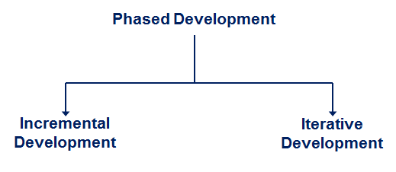
Incremental Development
Incremental development partitions a system by functionality
Early release starts with small, functional subsystem, later releases add functionality

Slide 29
Incremental Model (Diagram)
Increment #1
Communication
Planning
Modeling
Construction
Increment #2
Deployment
Communication
Planning
Modeling
Construction
Increment #3
Deployment
Communication
Planning
Modeling
Construction
Deploy………
29

Slide 30
Incremental Model (Description)
Used when requirements are well understood
Multiple independent deliveries are identified
Work flow is in a linear (i.e., sequential) fashion within an increment and is staggered between increments
Iterative in nature; focuses on an operational product with each increment
Provides a needed set of functionality sooner while delivering optional components later
Useful also when staffing is too short for a full-scale development
30

Slide 31
Incremental development benefits
The cost of accommodating changing customer requirements is reduced.
The amount of analysis and documentation that has to be redone is much less than is required with the waterfall model.
It is easier to get customer feedback on the development work that has been done.
Customers can comment on demonstrations of the software and see how much has been implemented.
More rapid delivery and deployment of useful software to the customer is possible.
Customers are able to use and gain value from the software earlier than is possible with a waterfall process.

Slide 32
Incremental development problems
The process is not visible.
Managers need regular deliverables to measure progress. If systems are developed quickly, it is not cost-effective to produce documents that reflect every version of the system.
System structure tends to degrade as new increments are added.
Unless time and money is spent on refactoring to improve the software, regular change tends to corrupt its structure. Incorporating further software changes becomes increasingly difficult and costly.

Slide 33
Iterative Development
Iterative development improves overall system in each release
Delivers a full system in the first release, then changes the functionality of each subsystem with each new release

Slide 34



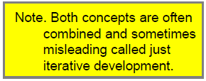



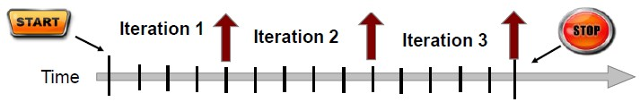
Iterative vs. Incremental Development
Incremental Development
Add a new "part" at each increment
Iterative Development
Improve a "working system" at each iteration

Slide 35
Iterative Development - Pros
Misunderstandings and inconsistency are made clear early (e.g. between requirement, design, and implementation)
Encourage to use feedback -> elicit the real requirements
Forced to focus on the most critical issues
Continuous testing offers project assessment
Workload is spread out over time (especially test)
The team can get "lesson learned" and continuously improve the process
Stakeholders gets concrete evidence of progress

Slide 36
Iterative Development - Cons
Problem with current business contracts, especially fixed-price contracts
With short iterations it can be hard to map customer requirements to iterations

Slide 37
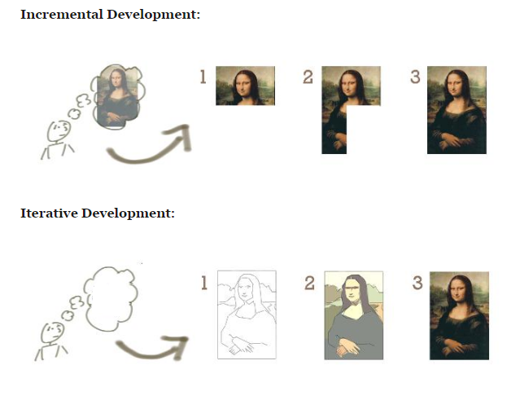

Slide 38
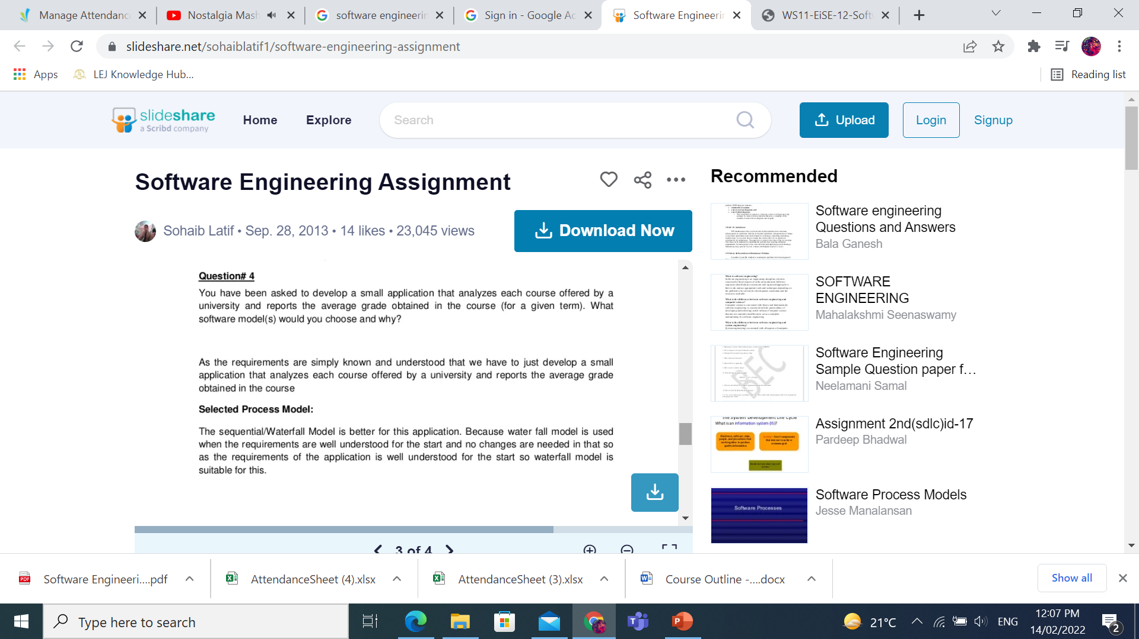
Activity 1

Slide 39
Activity 2
Giving reasons for your answer based on the type of system being developed, suggest the most appropriate generic software process model that might be used as a basis for managing the development of the following systems:
a) A system to control anti-lock braking in a car
b) An interactive travel planning system that helps users plan journey with the lowest environment impact.

Slide 40
Activity 1

Slide 41
Activity 2
Anti-lock braking system This is a safety-critical system so requires a lot of up-front analysis before implementation. It certainly needs a plan-driven approach to development with the requirements carefully analysed. A waterfall model is therefore the most appropriate approach to use, perhaps with formal transformations between the different development stages.
Interactive travel planning system with a complex user interface but which must be stable and reliable. An incremental development approach is the most appropriate as the system requirements will change as real user experience with the system is gained.

Slide 42
Reference
Chapter 2, I. Sommerville, Software Engineering, 9th Edition, Pearson Education, 2011.

